Slide 1


Department of Data Science
Early Lung Cancer Detection: Advancing Deep Learning with Capsule Neural Networks
Presented By: Aizaz Shabber Khan
2024(S)-MS-DS-06
Supervisor: Dr. Ayesha Altaf
University of Engineering and Technology, Lahore

Slide 2
Research Objectives
Introduction
Problem
Research Objectives
Literature Review
Work flow
Key Studies & Contributions
Research Gap
Methodology
Implementation Framework
Utilization of Research Results
Research Outcomes & Deliverables
Research Timeline & Next Steps

Slide 3
The Problem
Lung Cancer Mortality
Limitations of CNNs
Unexplored Potential
Lung cancer remains a leading cause of cancer-related deaths worldwide, underscoring the critical need for effective early detection methods.
Traditional CNNs, while effective, lose crucial spatial information due to pooling operations, leading to high false positive rates and a need for extensive data.
The application of Capsule Neural Networks, designed to preserve spatial relationships, is largely unexplored in lung nodule detection.
This research addresses these challenges by exploring CapsNets as a superior alternative for early, accurate, and efficient lung cancer diagnosis.

Slide 4
Research Objectives
1
Analyze CNN Limitations
To systematically analyze and document the specific limitations of traditional CNNs in lung nodule detection, with a focus on spatial information loss and false positives.
2
Design CapsNet Architectures
To design and implement novel Capsule Neural Network architectures optimized for lung nodule detection from CT scans, leveraging dynamic routing for spatial preservation.
3
Develop & Evaluate Models
To develop and rigorously evaluate multiple CapsNet models for classifying CT scan regions into nodule and non-nodule categories, emphasizing enhanced spatial awareness.
4
Assess Performance Metrics
To assess the impact of CapsNet implementation on critical prediction metrics such as accuracy, sensitivity, specificity, and false positive reduction using the LIDC-IDRI dataset.
5
Address Deployment Concerns
To investigate computational efficiency and practical deployment concerns for CapsNet-based systems, proposing frameworks for seamless integration into healthcare screening programs.

Slide 5
Literature Survey: Current Landscape & Gaps
The literature survey underscores the momentum of deep learning in medical imaging, particularly for lung cancer detection, while also highlighting the persistent limitations of current approaches.
CNNs in Lung Nodule Detection: Extensive application, but challenges with spatial information loss and high false positive rates persist, requiring large datasets for optimal performance.
Capsule Networks (CapsNets): Introduced by Hinton, CapsNets offer a promising alternative by preserving spatial hierarchies through dynamic routing, potentially outperforming CNNs with less data.
Research Gap: Despite theoretical advantages, comprehensive comparative studies of CapsNets versus CNNs for lung nodule detection are lacking, especially concerning practical benefits and deployment feasibility in clinical settings.

Slide 6
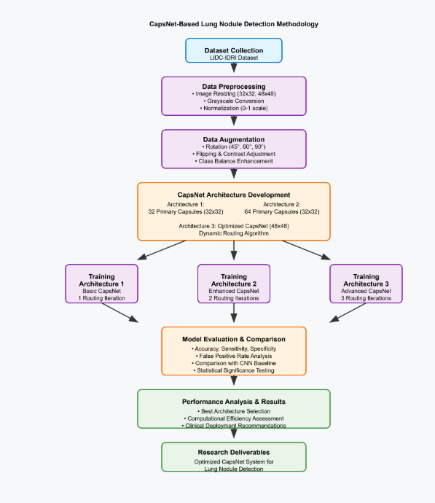
Workflow

Slide 7
Key Studies & Contributions
A brief overview of seminal works shaping the landscape of deep learning in medical imaging and lung nodule detection.
Year
Author & Title
Purpose
Model/Dataset
Key Finding/Limitation
2017
Sabour et al. (CapsNet)
Introduce CapsNet
CapsNet / MNIST
Preserves spatial info; limited medical testing.
2017
Song et al. (CNN Lung Nodules)
Compare CNN models
CNN, DNN / LIDC-IDRI
84.15% accuracy; high false positives.
2016
Setio et al. (LUNA16 Challenge)
Validate nodule detection
Various / LUNA16
Standardized evaluation; algorithm-specific limits.
2016
Shin et al. (CNN CAD)
Evaluate CNN architectures
Deep CNNs / Thoraco-abdominal
85% sensitivity; transfer learning challenges.
2011
NLSTR Team (CT Screening)
Evaluate CT screening
Clinical trial / 53,454 pts
20% mortality reduction; manual interpretation.

Slide 8
Research Gap
1
Limited exploration of CapsNet applications in medical imaging, particularly lung cancer detection.
2
Lack of comparative studies between CapsNet and CNN for lung nodule detection accuracy.
3
Insufficient evidence of CapsNet's spatial preservation benefits in medical diagnosis
4
Gap in understanding CapsNet performance on small medical datasets like LIDC-IDRI.
5
Limited studies on CapsNet's claimed advantage of requiring less training data for medical imaging.

Slide 9



Methodology
Dataset Collection & Preprocessing
CapsNet Architecture Design
Data Augmentation & Training
Utilize the LIDC-IDRI dataset (1018 CT scans), resize to 32x32 and 48x48, normalize, grayscale convert, and handle class imbalance.
Develop three distinct CapsNet architectures of varying complexity, implementing encoder-decoder structures with primary and class capsule layers.
Apply rotation (45°, 60°, 90°), flipping, and contrast adjustment. Train using Adam optimizer, batch normalization, and Leaky ReLU.
Model Development & Comparison
Evaluation & Analysis
Train three CapsNet architectures (Basic, Enhanced, Advanced) and compare their performance against traditional CNN baselines.
Assess models using accuracy, sensitivity, specificity, and FPR. Conduct statistical analysis, and evaluate computational efficiency.

Slide 10
Implementation Framework
Software & Tools
Hardware & Data Management
Programming: Python 3.x
Hardware: GPU-accelerated workstation (e.g., Tesla K80)
Frameworks: PyTorch, TensorFlow
Data Storage: Secure storage with version control (Git) for reproducibility
Libraries: NumPy (numerical operations), OpenCV (image processing)
Visualization: Matplotlib
Evaluation Metrics
Accuracy
Precision
Recall
F1-Score
ROC-AUC
False Positive Rate per patient

Slide 11
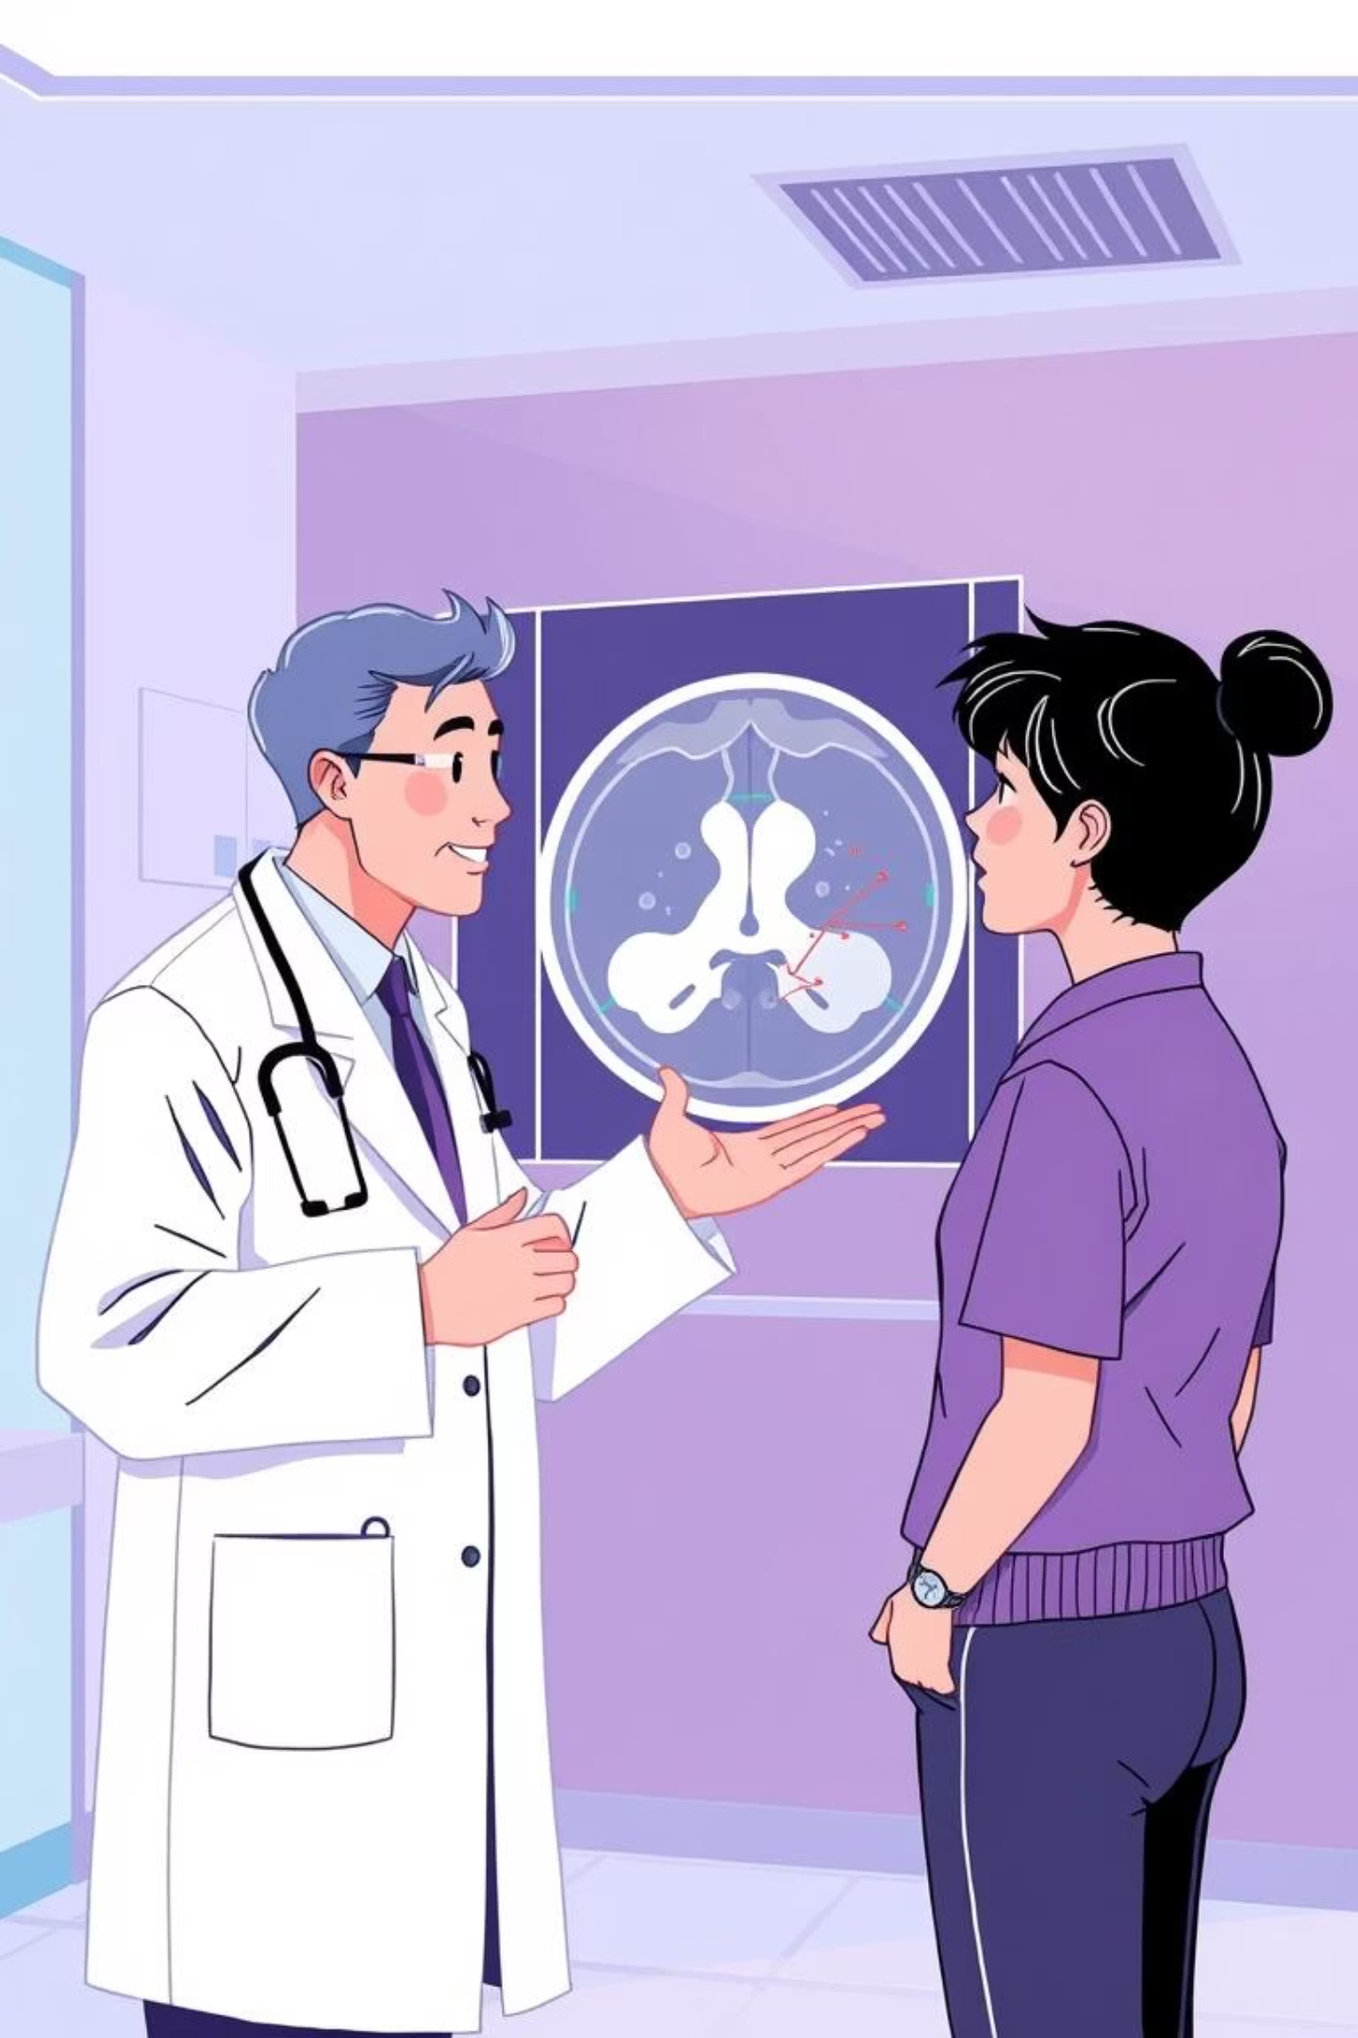
Utilization of Research Results
This research aims to bridge the gap between advanced deep learning and real-world clinical applications, significantly impacting healthcare AI systems for lung cancer detection.
Enhanced Diagnostic Accuracy
Improved Screening Programs
CapsNets can significantly improve diagnostic accuracy and reduce false positives in automated lung nodule detection.
Hospitals can leverage these findings to build more reliable computer-aided diagnosis tools, especially in regions with limited radiological expertise.
Academic Contribution
Provide novel methodologies for applying CapsNets to medical imaging tasks, establishing critical benchmarks for future research.

Slide 12
Research Outcomes & Deliverables
1
2
3
Automated Detection System
Optimized CapsNet Architectures
Comprehensive Performance Evaluation
Development of a CapsNet-based system demonstrating superior spatial awareness and reduced false positive rates.
Three optimized CapsNet architectures tailored for lung nodule detection, with varying complexity and input sizes.
Detailed comparison between CapsNet and CNN approaches using the LIDC-IDRI dataset.
4
5
Computational Efficiency Analysis
Technical Documentation & Framework
Evaluation of practical deployment considerations for clinical use.
Includes network specs, training protocols, evaluation methodologies, and a complete PyTorch implementation.

Slide 13

Research Timeline & Next Steps
Month
Activities
1-2
Literature review, dataset acquisition, preprocessing, and augmentation pipeline.
3-4
Implementation of CapsNet Architectures 1, 2, and 3; initial training and hyperparameter tuning.
5-6
Comprehensive training, performance evaluation, CNN baseline implementation, and comparative analysis.
7-8
Results analysis, visualization, computational efficiency evaluation, documentation, and thesis writing.
This research is poised to contribute significantly to early lung cancer detection, ultimately improving patient outcomes and advancing medical imaging diagnostics through innovative deep learning approaches.

Slide 14
Thank You

